Slide 1


Mutual Fund Analytics Capstone Project Advanced Data Analytics & Business Intelligence
July 24th, 2026
By: Seelam Venu Keerthana

Slide 2

Problem Statement
The mutual fund industry generates massive amounts of financial data every day.
Investors often struggle to:
Select suitable mutual funds
Compare fund performance
Measure investment risk
Track portfolio growth
Make data-driven investment decisions
Solution: Develop a comprehensive Mutual Fund Analytics Platform using:
->Python ->SQLite ->Power BI ->Data Analytics ->Financial Performance Metrics

Slide 3

Project Objectives
OBJECTIVES
Analyze historical NAV data
Study investor behaviour
Evaluate fund performance
Calculate financial metrics
Build interactive dashboards
Recommend high-performing mutual funds
Measure investment risk using Value at Risk (VaR)

Slide 4

Dataset Overview
Dataset Used
Total Records
My project consists of 10 datasets:
Fund Master
NAV History
AUM by Fund House
Monthly SIP Inflows
Category Inflows
Industry Folio Count
Scheme Performance
Investor Transactions
Portfolio Holdings
Benchmark Indices
Total NAV Records: 46000
Total Investor Transactions: 32778
Total Mutual Fund Schemes: 40
Fund Houses: 10
Categories: 2
States: 12
Unique Investors: 5000

Slide 5

CSV Files ↓ Data Cleaning ↓ Feature Engineering ↓ SQLite Database ↓ Python Analytics ↓ Power BI Dashboard
ETL Pipeline
ETL Workflow:
Mention:
Data Cleaning
Missing Value Handling
Duplicate Removal
Data Validation
SQL Integration

Slide 6

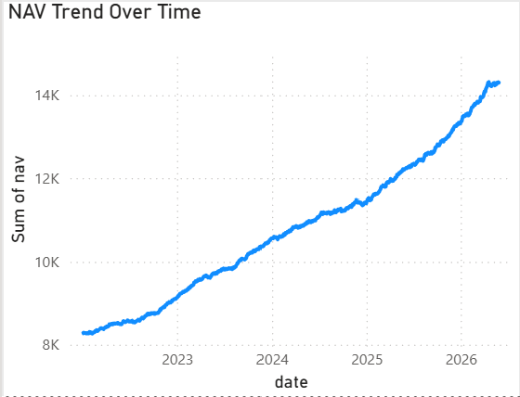
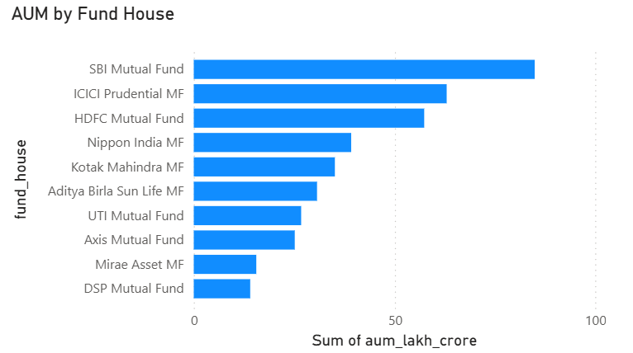
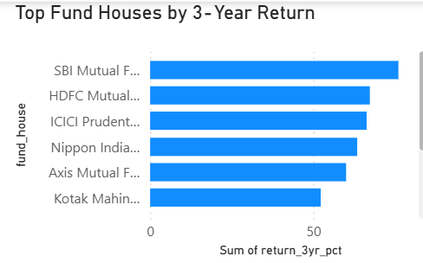
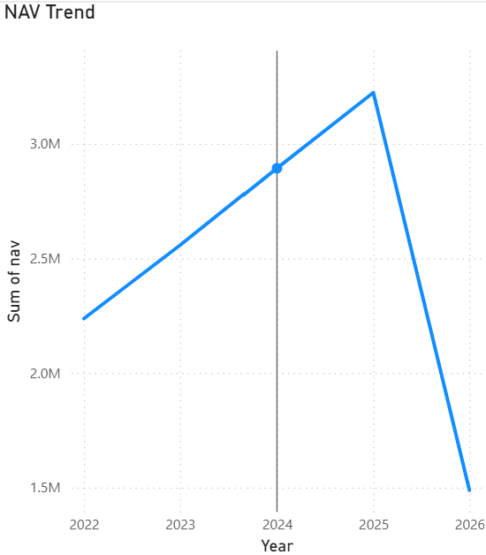
Exploratory Data Analysis
Key Insights:
Large Cap funds have stable returns.
Small Cap funds show higher volatility.
Liquid funds exhibit the lowest risk.
Direct plans generally have lower expense ratios.

Slide 7

Performance Analytics
Financial Metrics Calculated
CAGR
Sharpe Ratio
Sortino Ratio
Alpha
Beta
Maximum Drawdown
Standard Deviation
Annual Returns
These metrics help evaluate risk-adjusted fund performance.

Slide 8
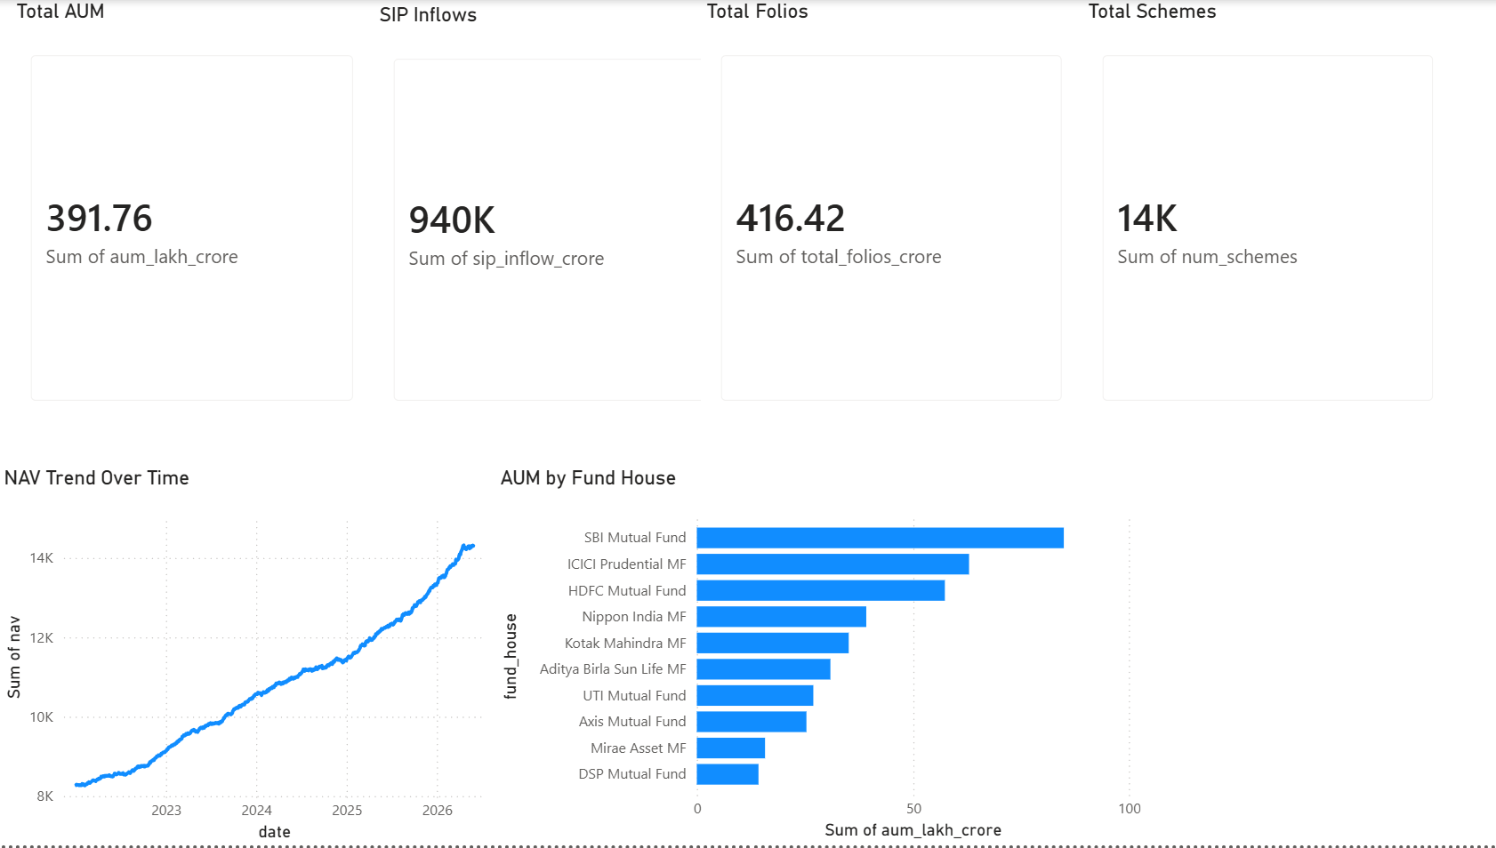
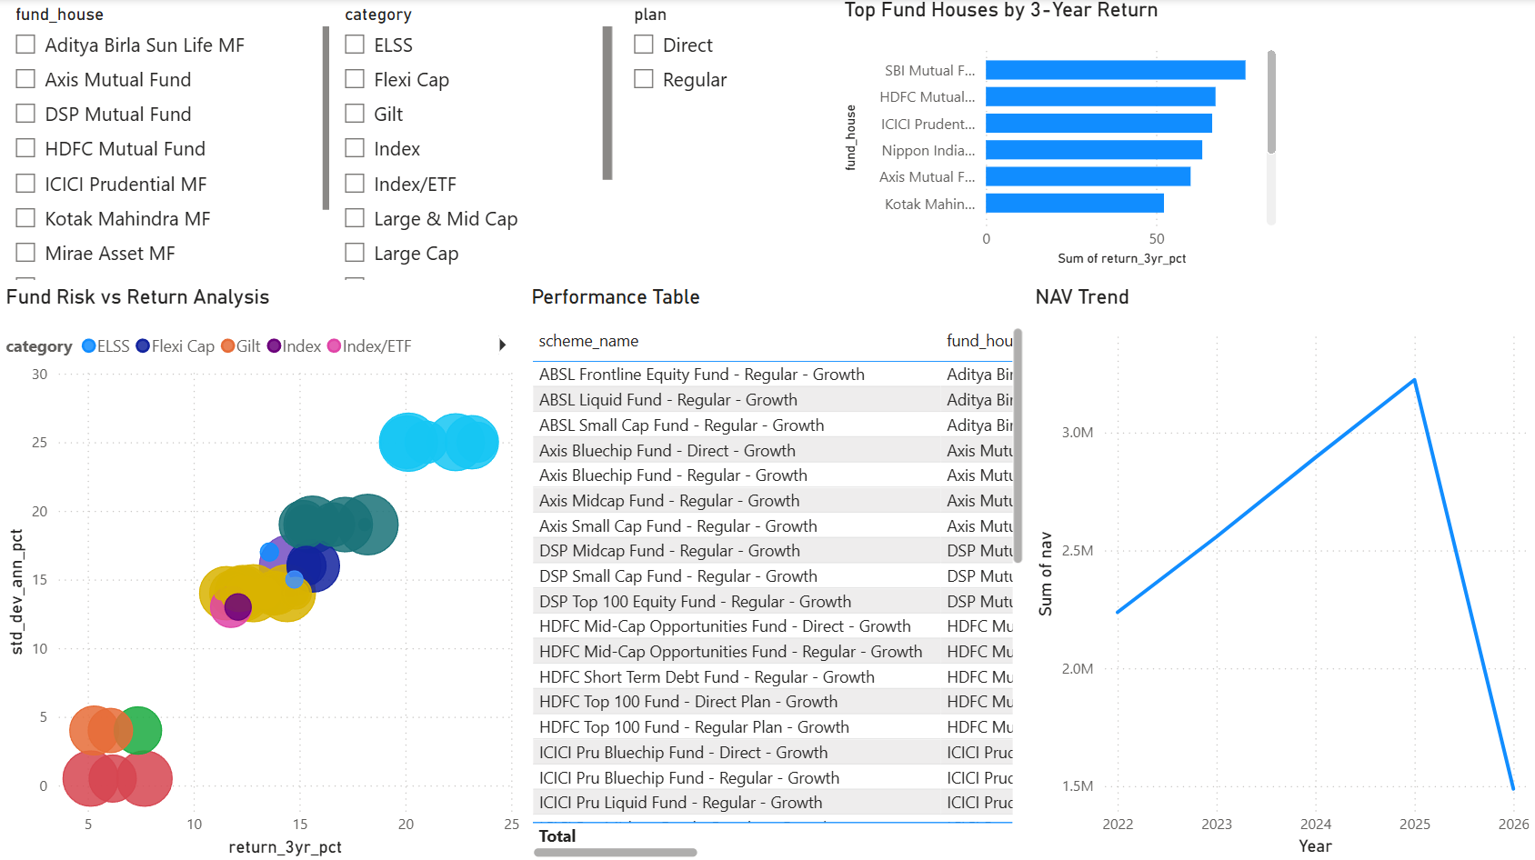
Power BI Dashboard
Image 1: Industry Overview
Image 2: Fund Performance

Slide 9
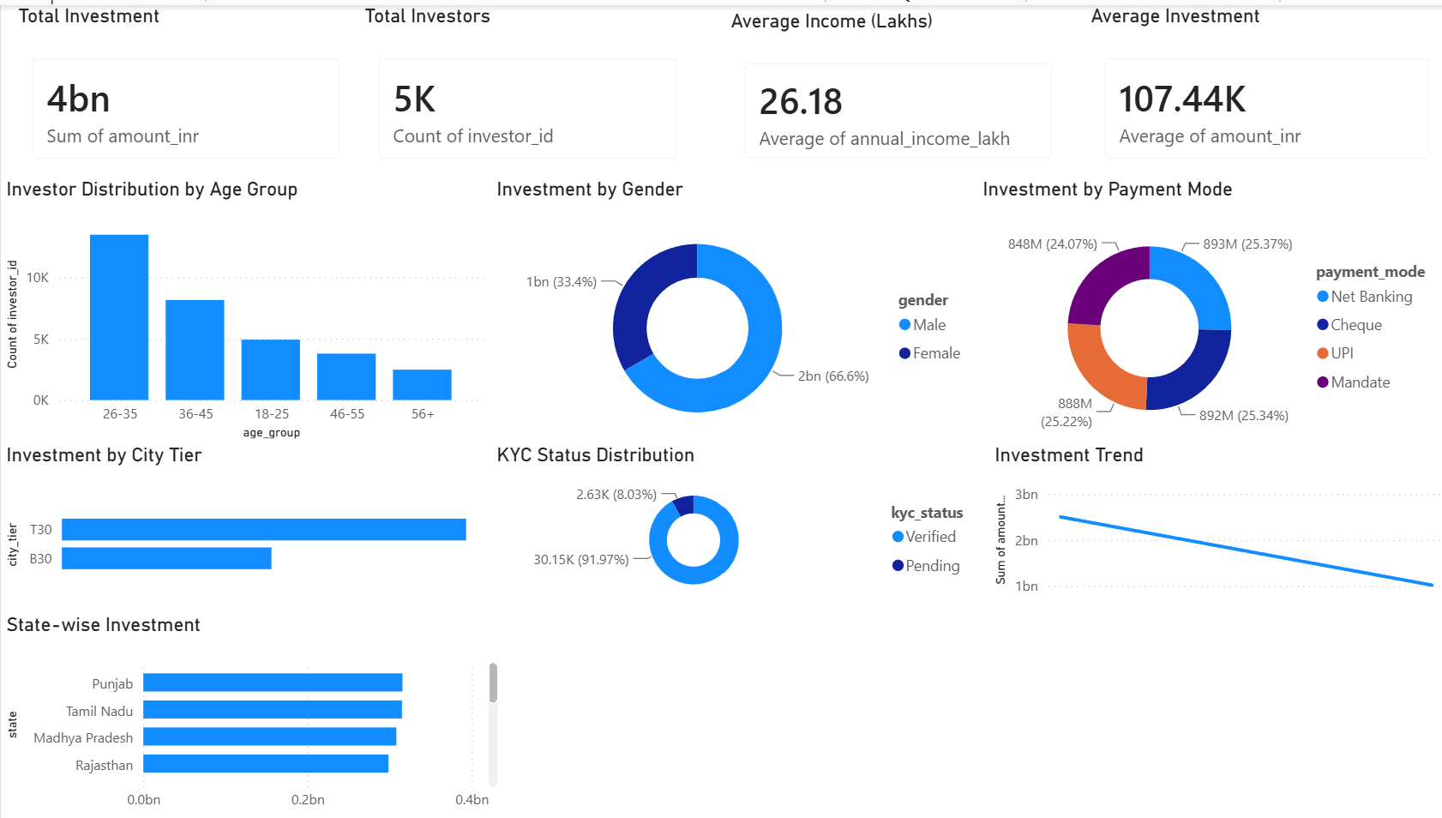
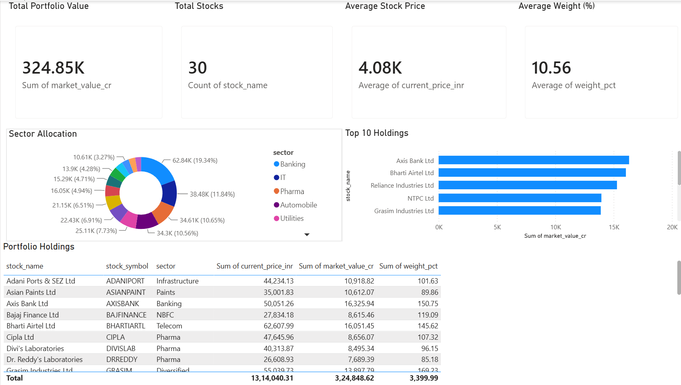
Power BI Dashboard
Image 3: Investor Analytics
Image 4: Portfolio Holdings

Slide 10
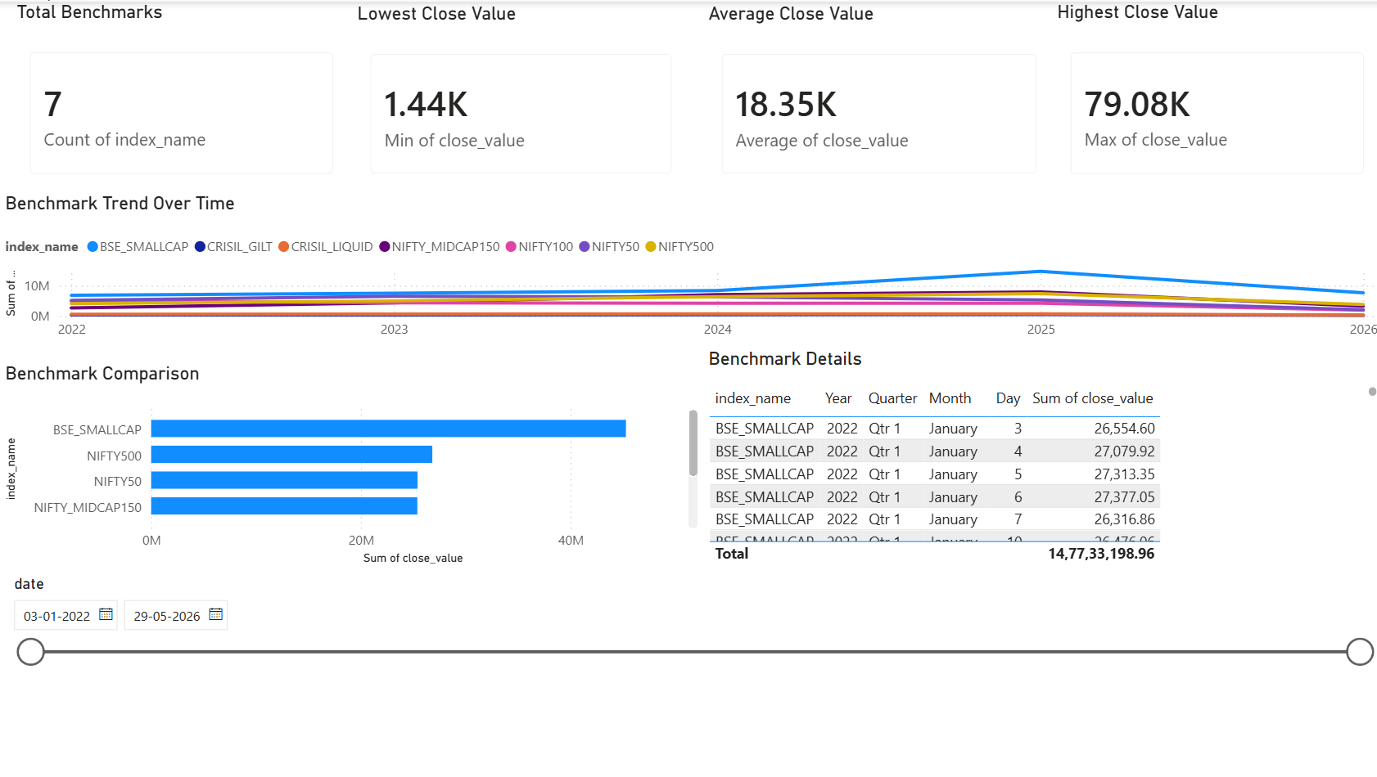
Power BI Dashboard
Image 5: Benchmark Analysis

Slide 11
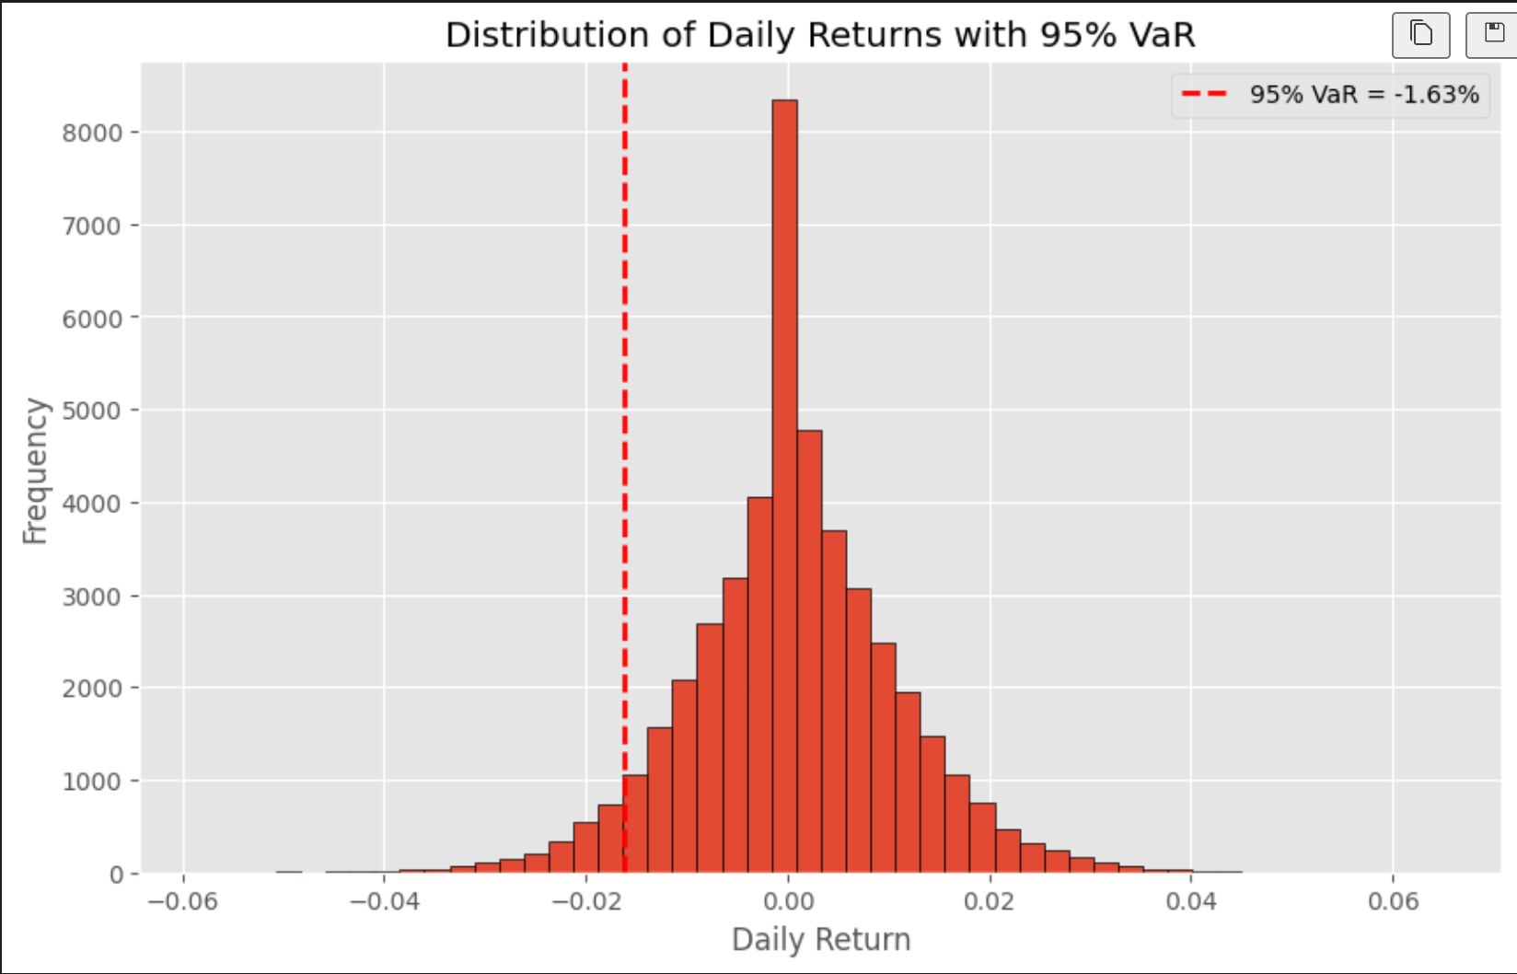
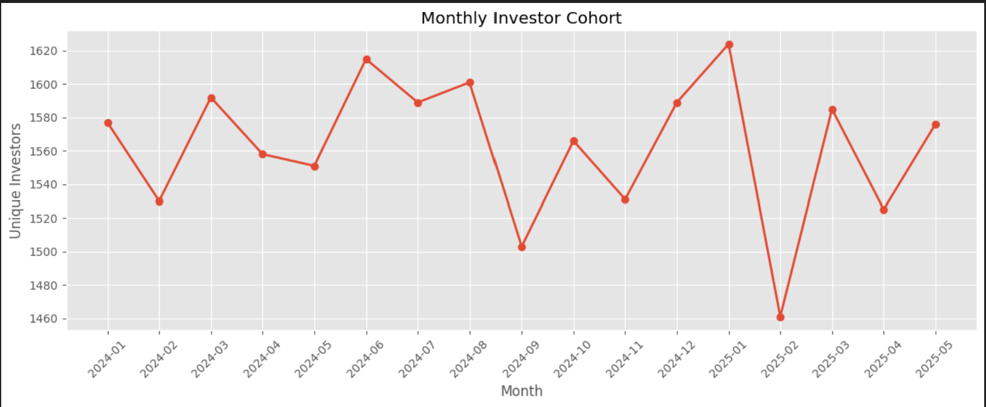
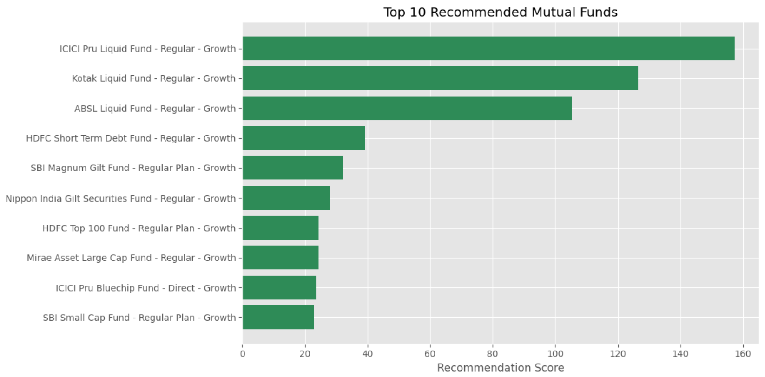
Advanced Analytics
Daily Return Calculation
Historical VaR (95%)
Monthly Investor Cohort Analysis
Recommendation Engine

Slide 12
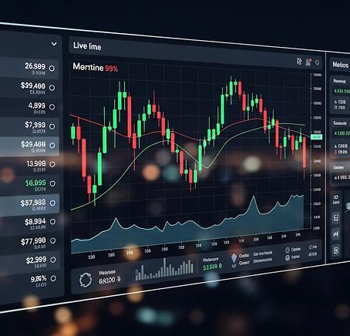
Key Findings
Successfully analyzed mutual fund performance.
Investors aged 26–35 contributed the highest investments.
Verified KYC investors dominated transactions.
Liquid funds achieved the highest recommendation scores.
Power BI dashboards enabled interactive analysis.
Risk metrics improved investment evaluation.

Slide 13
Conclusion & Future Scope
Conclusion
The project demonstrates how analytics and business intelligence can transform raw financial data into actionable investment insights.
Future Scope
Live Mutual Fund API Integration
AI-Based Fund Recommendation
Streamlit Web Application
Portfolio Optimization
Real-Time Dashboard

